Slide 1
Image Search
Snehal shaevya

Slide 2
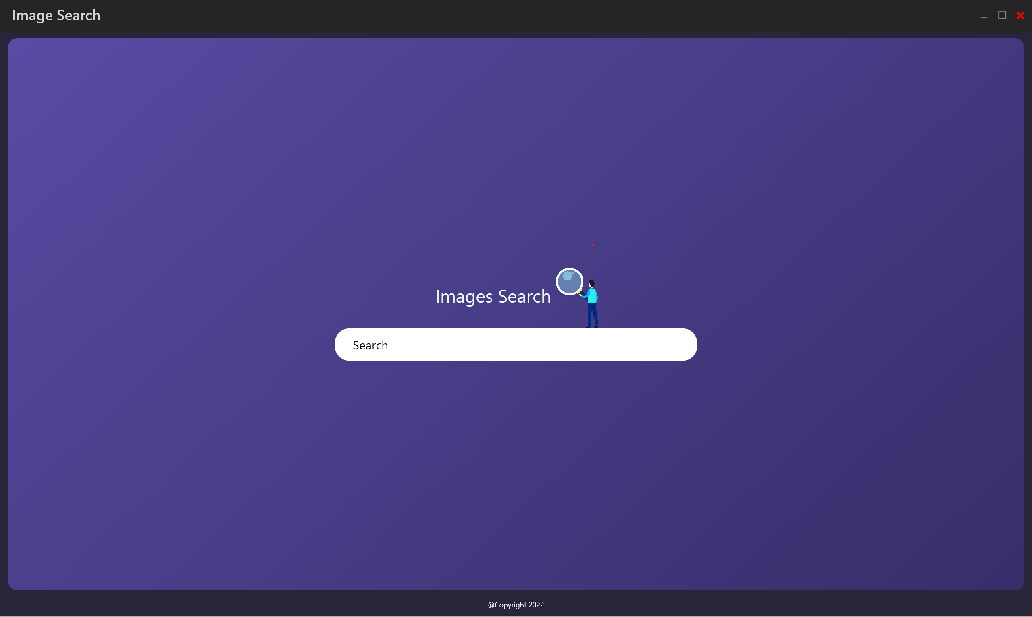
Application Overview

Slide 3
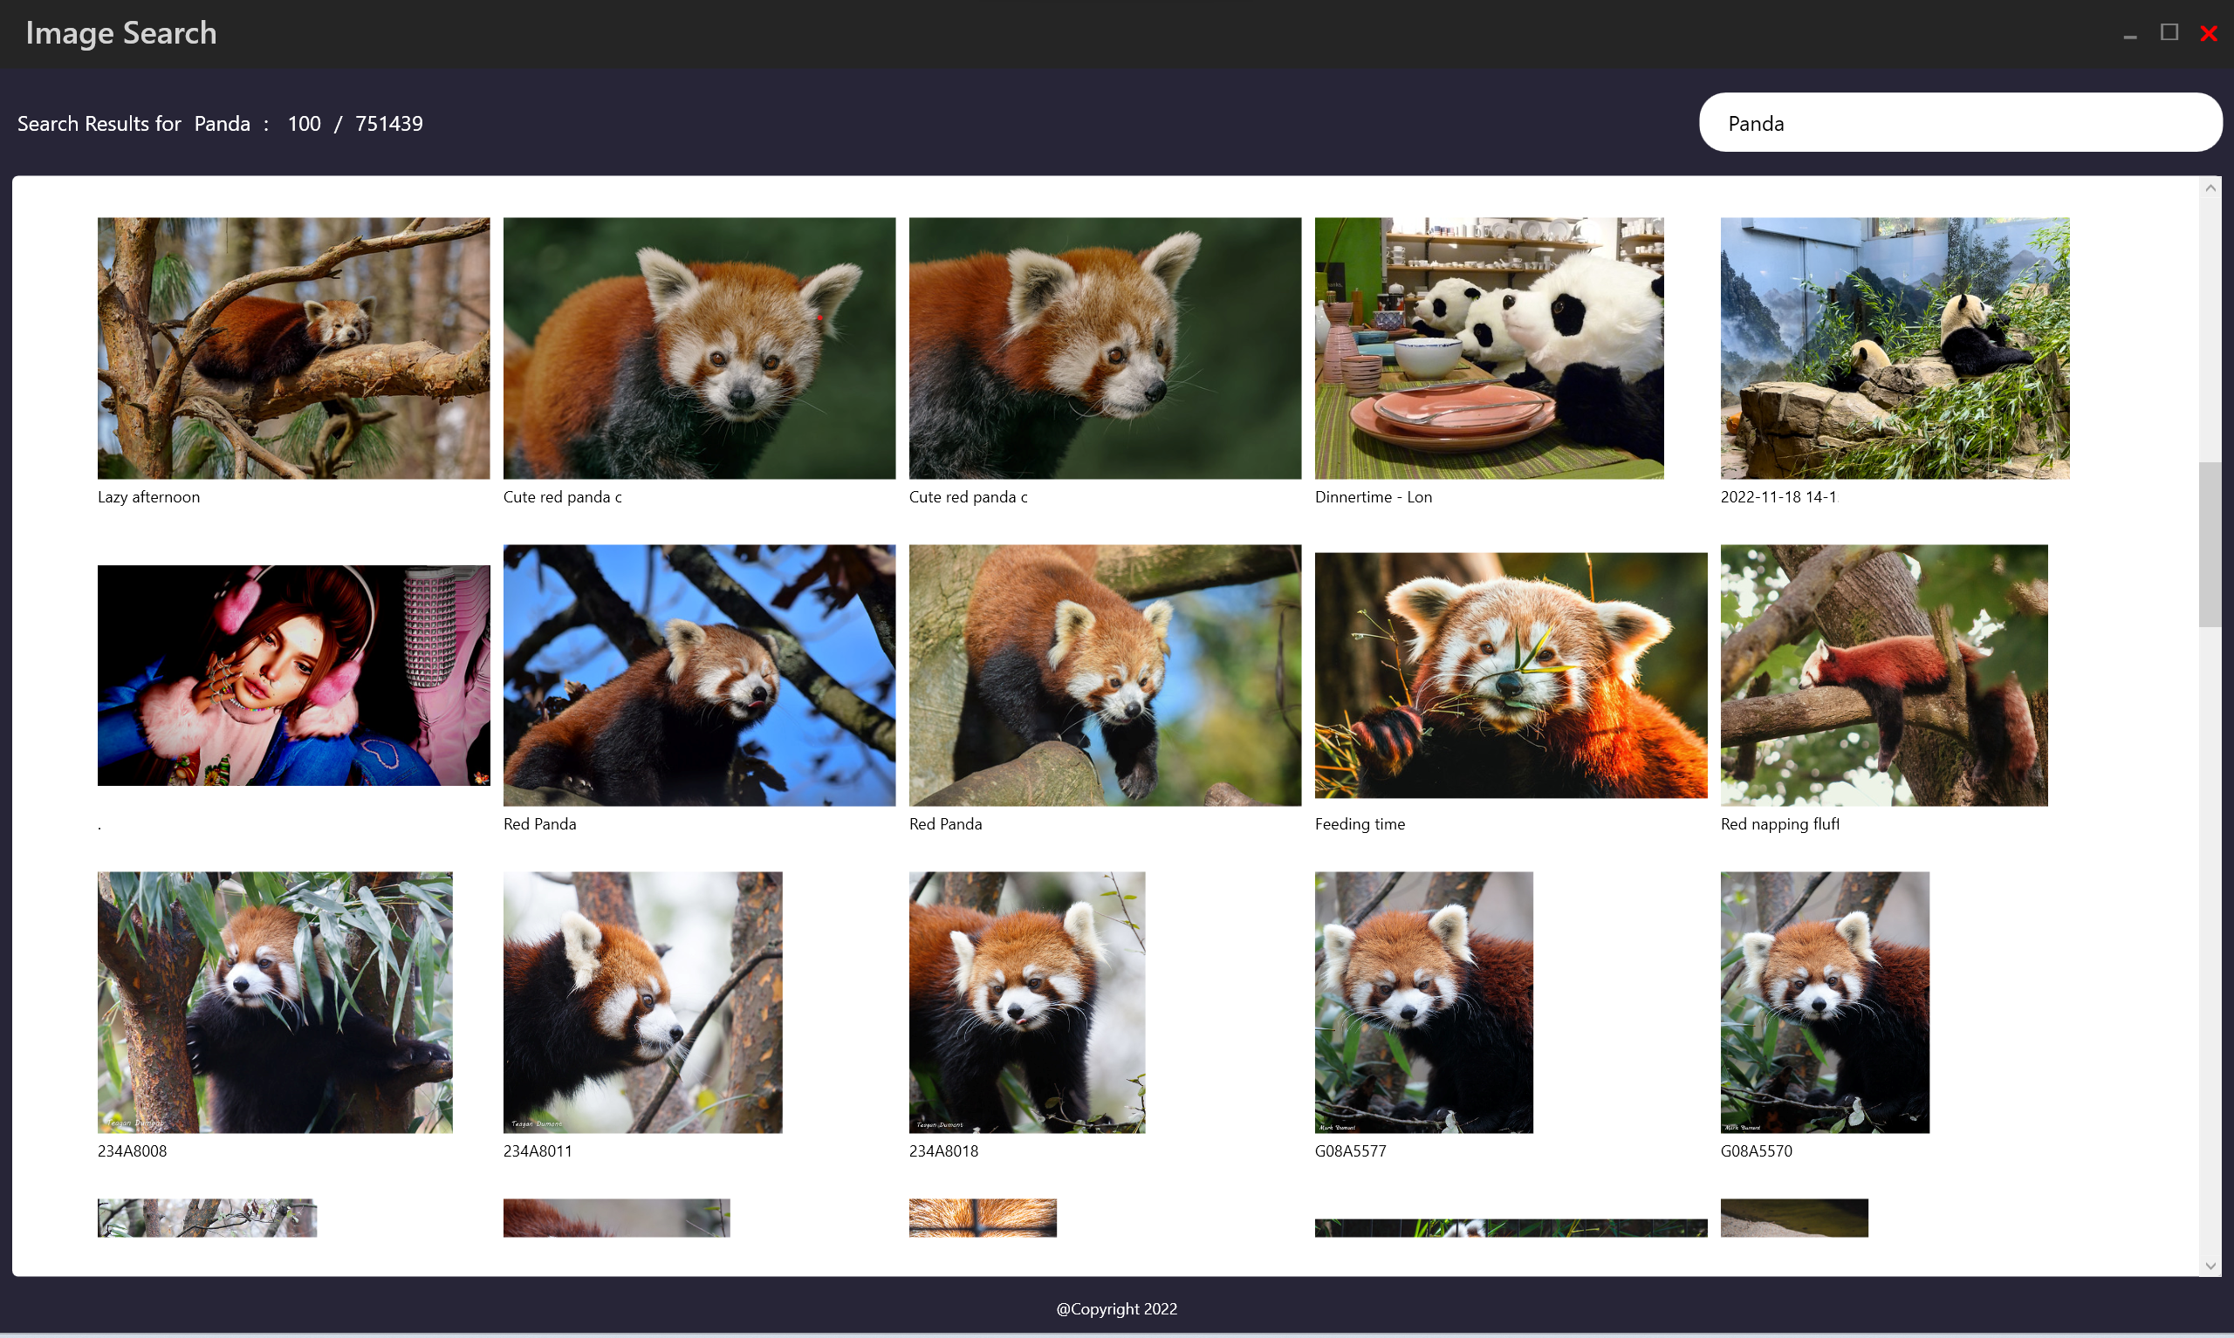
Application Overview

Slide 4
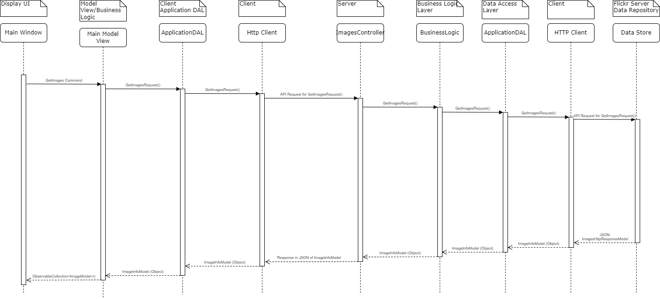
Sequence Diagram

